Slide 1
SQL PROJECT
Tata Motors Sales Dataset
A two-Table Relational Database
NAME: RASHMIN PATIL BATCH NO: KL352 TRAINER: ZAKAUR KHAN

Slide 2
AGENDA
PROJECT OBJECTIVES
1. To analyze overall sales performance of Tata Motors
2. To Identify top performing Car Sale,Car Category and customers.
3. TO evaluate monthly and Yearly Sales.
4. To measure which car model is profitable and generating sales.
5. Using the SQL commands and Queries, generate the data-driven insights

Slide 3
AGENDA
What This Presentation Covers
01 DDL, DML & DQL CREATE, ALTER, DROP, TRUNCATE, INSERT, UPDATE, DELETE, SELECT
02 Filtering and Sorting WHERE, ORDER BY, GROUP BY,HAVING, LIMIT & OFFSET, BETWEEN, IN, LIKE
03 Aggregate Function SUM(), COUNT(), AVG(), MIN(), MAX()
04 Function & Logic STRING, MATH,DATE AND TIME, COMPARISON, CASE
05 Joins INNER JOIN, LEFT JOIN, RIGHT JOIN
06 Windows Function RANK(), DENSERANK(), ROW_NUMBER(), OVER(),LAG().LEAD
07 Subqueries SINGLE ROW, MULTI-ROW, CORRELATED, NESTED

Slide 4
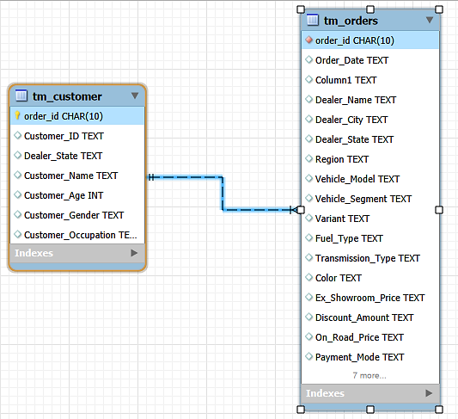
DATASET
TATA MOTORS Database: Two Related Tables
A simplified, relational version of the classic Superstore dataset — split into a Customers table and an Orders table, linked by CustomerID.
ER Diagram ONE to ONE RELATIONSHIP

Slide 5
Section 01/07
DDL, DML & DQL
Defining and modifying the database structure and its data

Slide 6
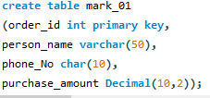

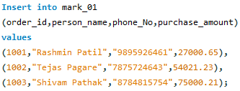
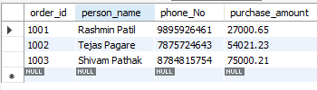
DDL,DML & DQL
01. Creating a New Table (CREATE TABLE)
02.Inserting Into the Table(INSERT TABLE)

Slide 7

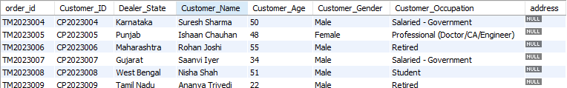

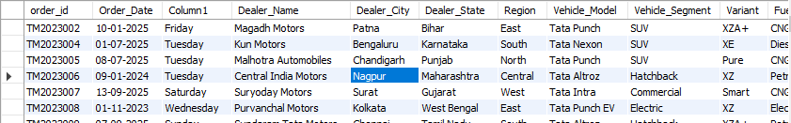
DDL,DML & DQL
03. Alter Table (ALTER TABLE)
ADD Column
04. Alter Table (ALTER TABLE)
Delete Row

Slide 8

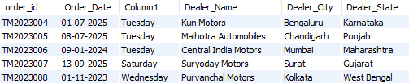


DDL,DML & DQL
05. Update Table (UPDATE TABLE)
Update the Dealer_name of order_id: TM2023006 from Nagpur to Mumbai
06. Truncate Table (TRUNCATE TABLE)
It Deletes the entire row of the table, leaving only table structure

Slide 9
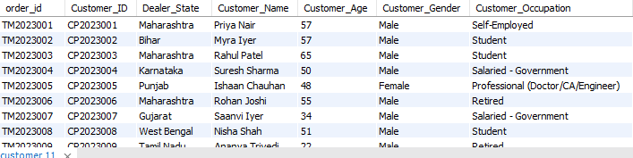
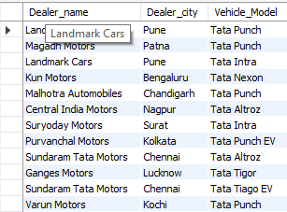
DDL,DML & DQL
07. Select Table (SELECT TABLE)
Viewing All Records in a Table
07. Select Column from Table (SELECT COLUMN)
Viewing specific column for Records in a Table

Slide 10
Section 02/07
Filtering & Sorting
Selecting, filtering, sorting, and de-duplicating rows from a single table.

Slide 11


FILTERING & SORTING
01 Filtering Rows with WHERE
Show me the Total Count of Vehicle_Model Tata safari and Tata Nexon in Pune city .

Slide 12

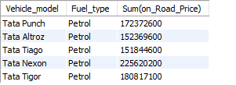
FILTERING & SORTING
02 Filtering Rows with GROUP BY
Find the Total Sum of On_Road_price of all the the vehicle whose fuel type is petrol

Slide 13
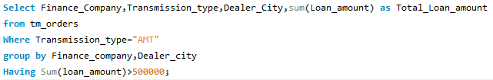
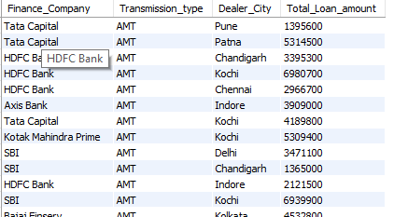
FILTERING & SORTING
03 Filtering Rows with HAVING
Find the Total_Loan_amount Distributed by Finance_company in Transmission_type “AMT” in all the city.

Slide 14
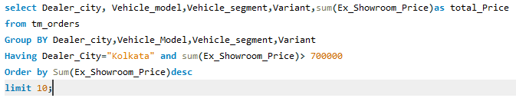
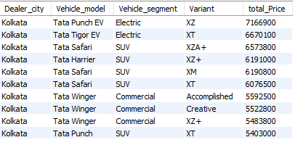
FILTERING & SORTING
04 Filtering Rows with ORDER BY
Find the total_sum of Ex_Showroom_price in Kolkata City and show it in Dealer_city Grouped.

Slide 15
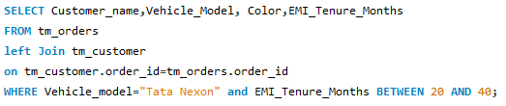
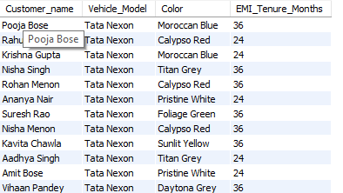
FILTERING & SORTING
05 Filtering Rows with BETWEEN
Find the EMI_Tenure_month between 20 to 40 Month of Tata Nexon for all the Customer

Slide 16
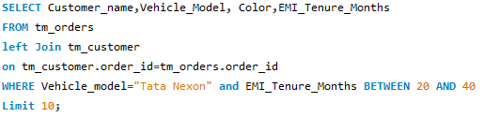
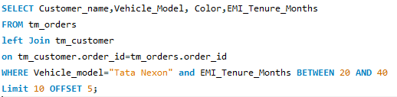
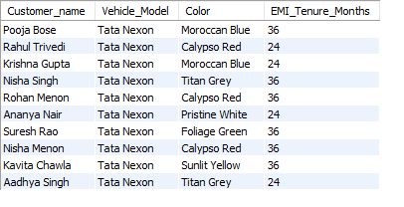
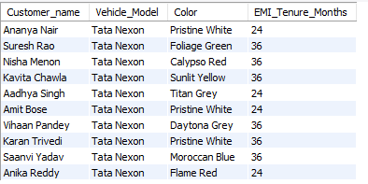
FILTERING & SORTING
06 Filtering Rows with LIMIT & OFFSET
Find the EMI_Tenure_month between 20 to 40 Month of Tata Nexon for all the Customer with Limit of 5 and starting from 6th row

Slide 17
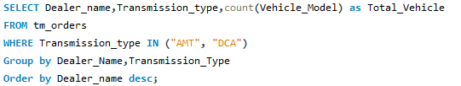
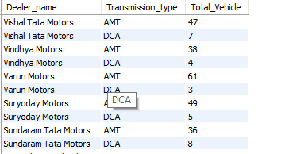
FILTERING & SORTING
07 Filtering Rows with IN
Show the Total_Vehicle of Only “AMT” and “DCA” by grouping in Dealer_name.

Slide 18
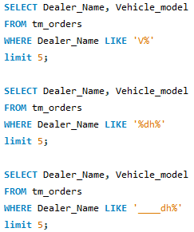
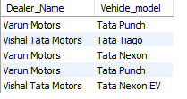
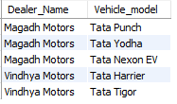
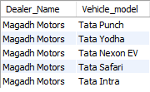
FILTERING & SORTING
08 Filtering Rows with Like
Show the Total_Vehicle of Only “AMT” and “DCA” by grouping in Dealer_name.

Slide 19
Section 03/07
Aggregate Function
Summarizing data with COUNT, SUM, AVG,MIN,MAX.

Slide 20
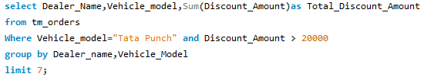
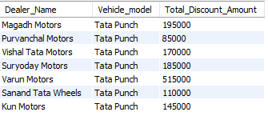
AGGREFATE FUNCTION
01 Aggregate Function: SUM
How the Total Sum Discount_amount for Vehicle_model Tata Punch

Slide 21
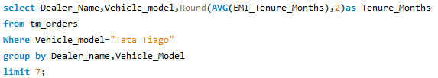
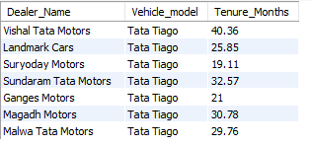
AGGREFATE FUNCTION
02 Aggregate Function: AVERAGE
Show the Average of EMI Tenure for dealer in Tata Tiago Model

Slide 22
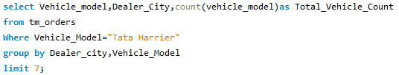
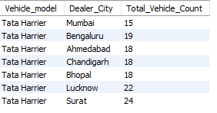
AGGREFATE FUNCTION
03 Aggregate Function: COUNT
Show the the total Count of Tata Harries Vehicle_model in all city

Slide 23

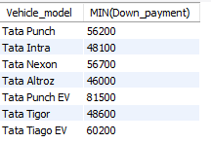
AGGREFATE FUNCTION
04 Aggregate Function: MIN
Show the Min Down_payment Each Vehicle_model has

Slide 24
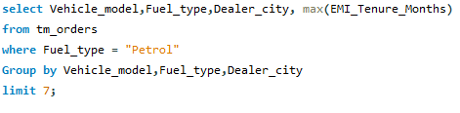
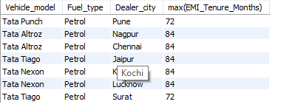
AGGREFATE FUNCTION
05 Aggregate Function: MAX
Show the max emit tenure of Tata Altroz in Petrol Varient in all the city

Slide 25
Section 0/07
JOINS
INNER JOIN, LEFT JOIN, RIGHT JOIN

Slide 26
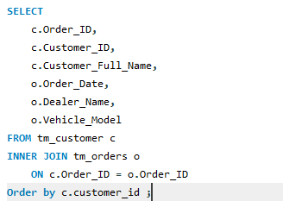
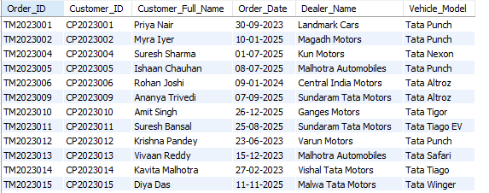
JOINS
01 INNER JOIN
Returns only the matching records from both tables.
Non-matching rows are excluded.

Slide 27
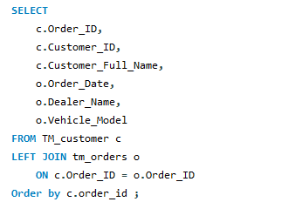
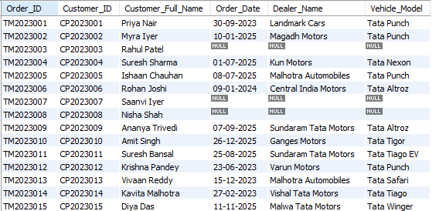
JOINS
02 LEFT JOIN
Returns all records from the left table and the matching records from the right table.
If there is no match, NULL values are returned for the right table.

Slide 28
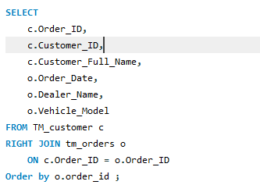
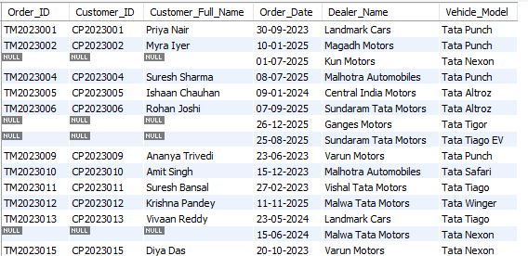
JOINS
03 RIGHT JOIN
Returns all records from the right table and the matching records from the left table.
If there is no match, NULL values are returned for the left table.

Slide 29
Section 04/07
Functions & Logic
Built-in string, Math, date

Slide 30


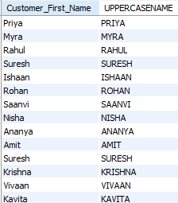
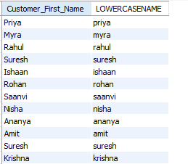
FUNCTION & LOGIC
01 STRING FUNCTION
01 UPPERCASE 02 LOWERCASE

Slide 31


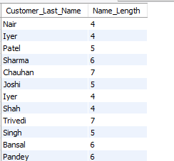

FUNCTION & LOGIC
01 STRING FUNCTION
03 LENGTH 04 SUB-STRING

Slide 32

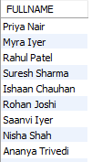
FUNCTION & LOGIC
01 STRING FUNCTION
05 CONCAT

Slide 33




FUNCTION & LOGIC
02 MATH FUNCTION
01 ROUND OF 02 CEIL

Slide 34


FUNCTION & LOGIC
02 MATH FUNCTION
03 MOD

Slide 35
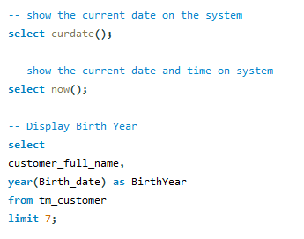


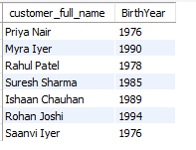
FUNCTION & LOGIC
03 DATE FUNCTION

Slide 36
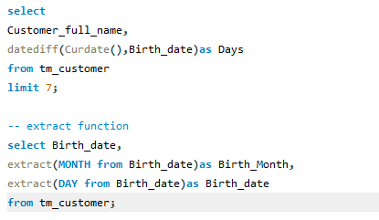
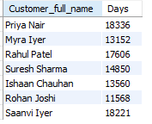
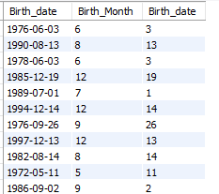
FUNCTION & LOGIC
03 DATE FUNCTION

Slide 37
Section 06/07
Windows Functions
Rank(), DenseRank(), Row_Number(), Lag() & Lead()

Slide 38


WINDOWS FUNCTIONS
SYNTAX OF WINDOWS FUNCTION

Slide 39




WINDOWS FUNCTIONS
01 RANK()
02 DENSERANK()

Slide 40


WINDOWS FUNCTIONS
03 ROW_NUMBER()

Slide 41




WINDOWS FUNCTIONS
04 LAG()
05 LEAD()

Slide 42
Section 07/07
SUBQUERIES
SingleRow, MultiRow, Correlated, Nested

Slide 43




SUBQUERIES
04 SingleRow()
05 Multi-ROW()

Slide 44




SUBQUERIES
04 Correlated Subquery()
05 Nested Subquery()

